Slide 1
Curating and Publishing Big Datasets Using CU Boulder High Performance Computing Infrastructure
Matthew Murray and Andrew Monaghan

Slide 2
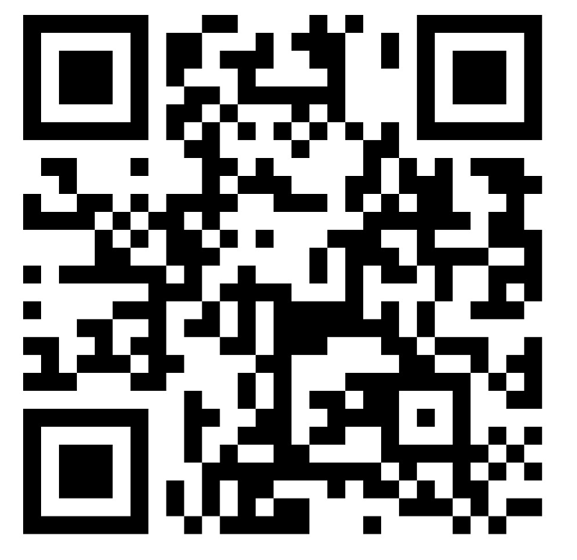
View the slides
https://github.com/ResearchComputing/rmacc_2025

Slide 3
Introduction
No two people on any campus will agree on what “Data” actually is
Publication of research datasets is now a requirement of most funding agencies and journals
Just publishing datasets in repositories isn’t enough to make research reproducible or replicable
Data curation is the process of ensuring that datasets are findable, accessible, and usable
Big data creates added challenges for curating and publishing data

Slide 4
What is Research Data?
3D models and printable files
Accreditation reports
Archival university papers
Artistry and performance materials
Audio
Books
Computer code & scripts
Conference proceedings
Course catalogs
Datasets
Designs & blueprints​
Digital journals
Dissertations
Documentation
GIS files
Grant proposals
“Grey” literature
Historical documents
Images
Interviews
Journals
Lab notebooks
Learning materials
Lecture transcriptions
Maps
Methodologies & Workflows
MOOCs
Newsletters
Oral History
Physical artifacts and specimens
Point clouds
Posters
Presentations
Seismic recordings
Software
Spreadsheets / CSV files
Surveys
Technical reports
Teaching tools designed by faculty
Theses
Transcripts
Video
Visualizations
Websites
White papers

Slide 5
What is a Repository?
A digital space used for publishing, sharing, and preserving works
Repositories include articles, reports, slide decks, theses, data, and more
There are general, domain-specific, national, and institutional
Content may be openly accessible immediately, embargoed to a future date, or only accessible to certain users
Gained popularity as many journals and funders now require data to be shared when articles are published

Slide 6
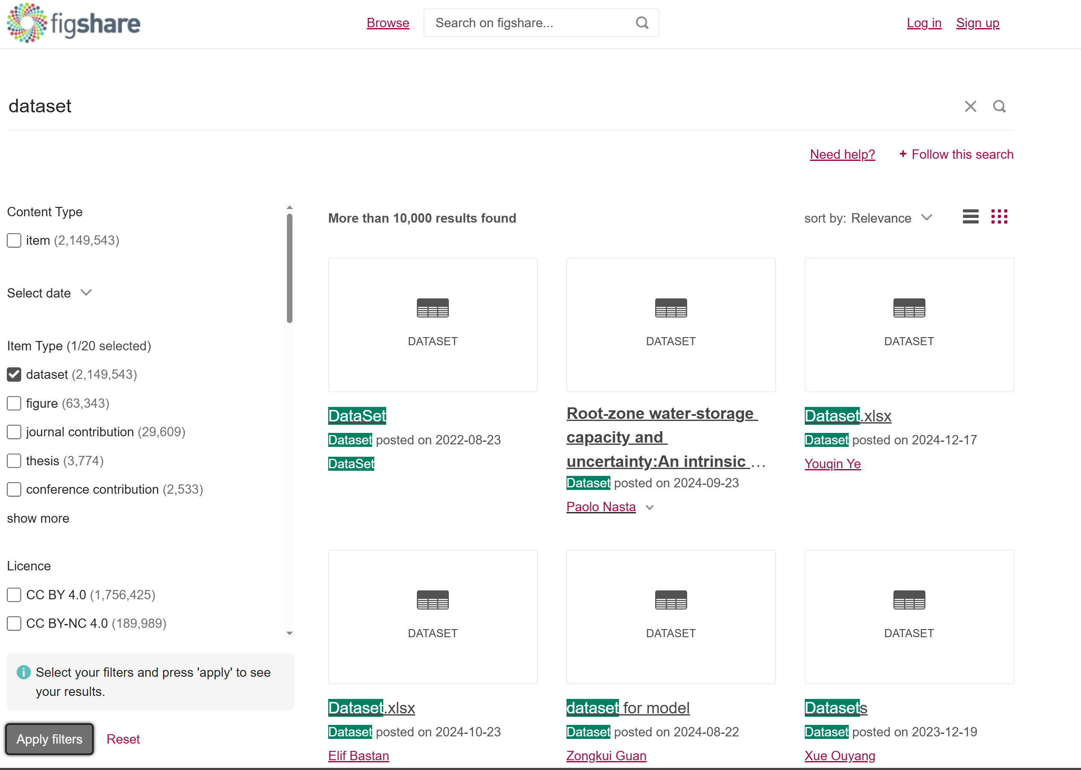
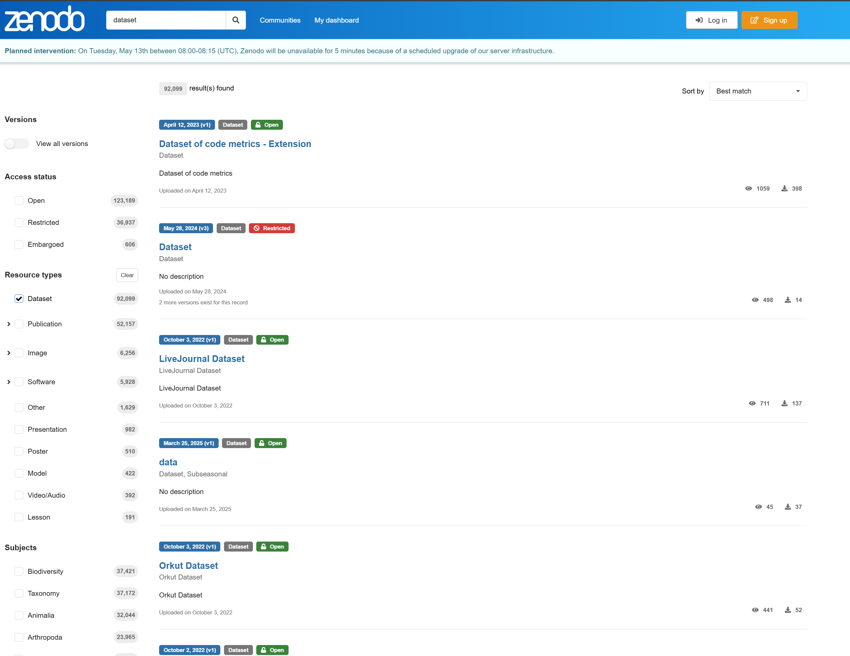
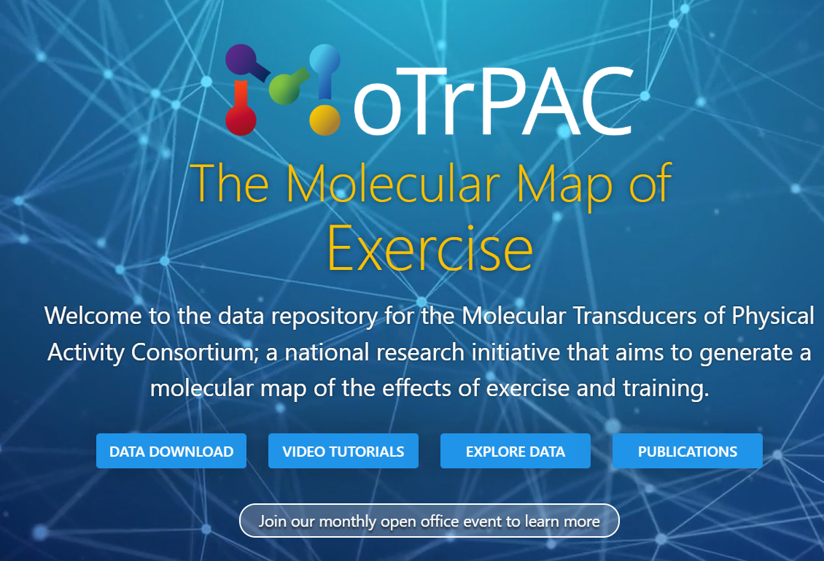
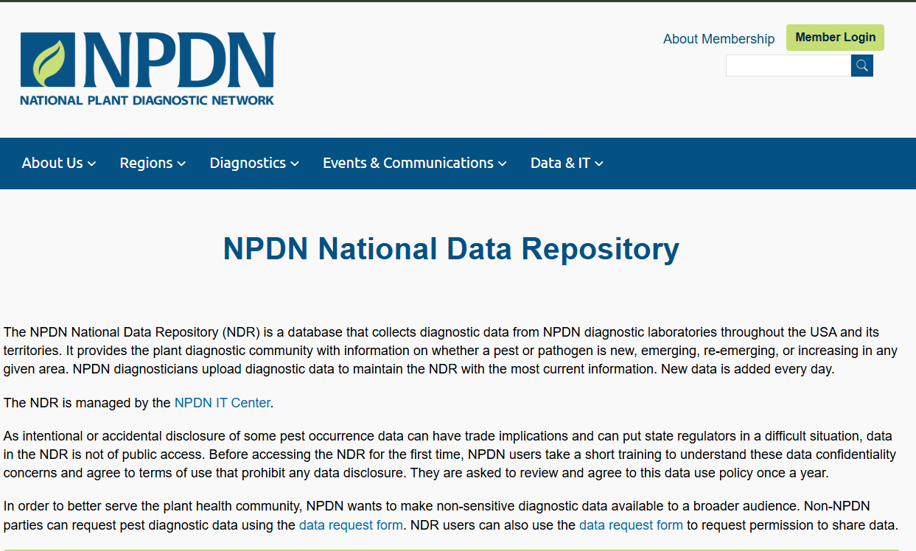

Slide 7
Institutional Repositories (IRs)
For work created by those affiliated with the institution
Usually run by libraries
Can be general (include articles, etc.) or data-specific
Data is usually associated with a published academic article
Repositories may allow for self-deposit and instant publication or require data to be curated

Slide 8
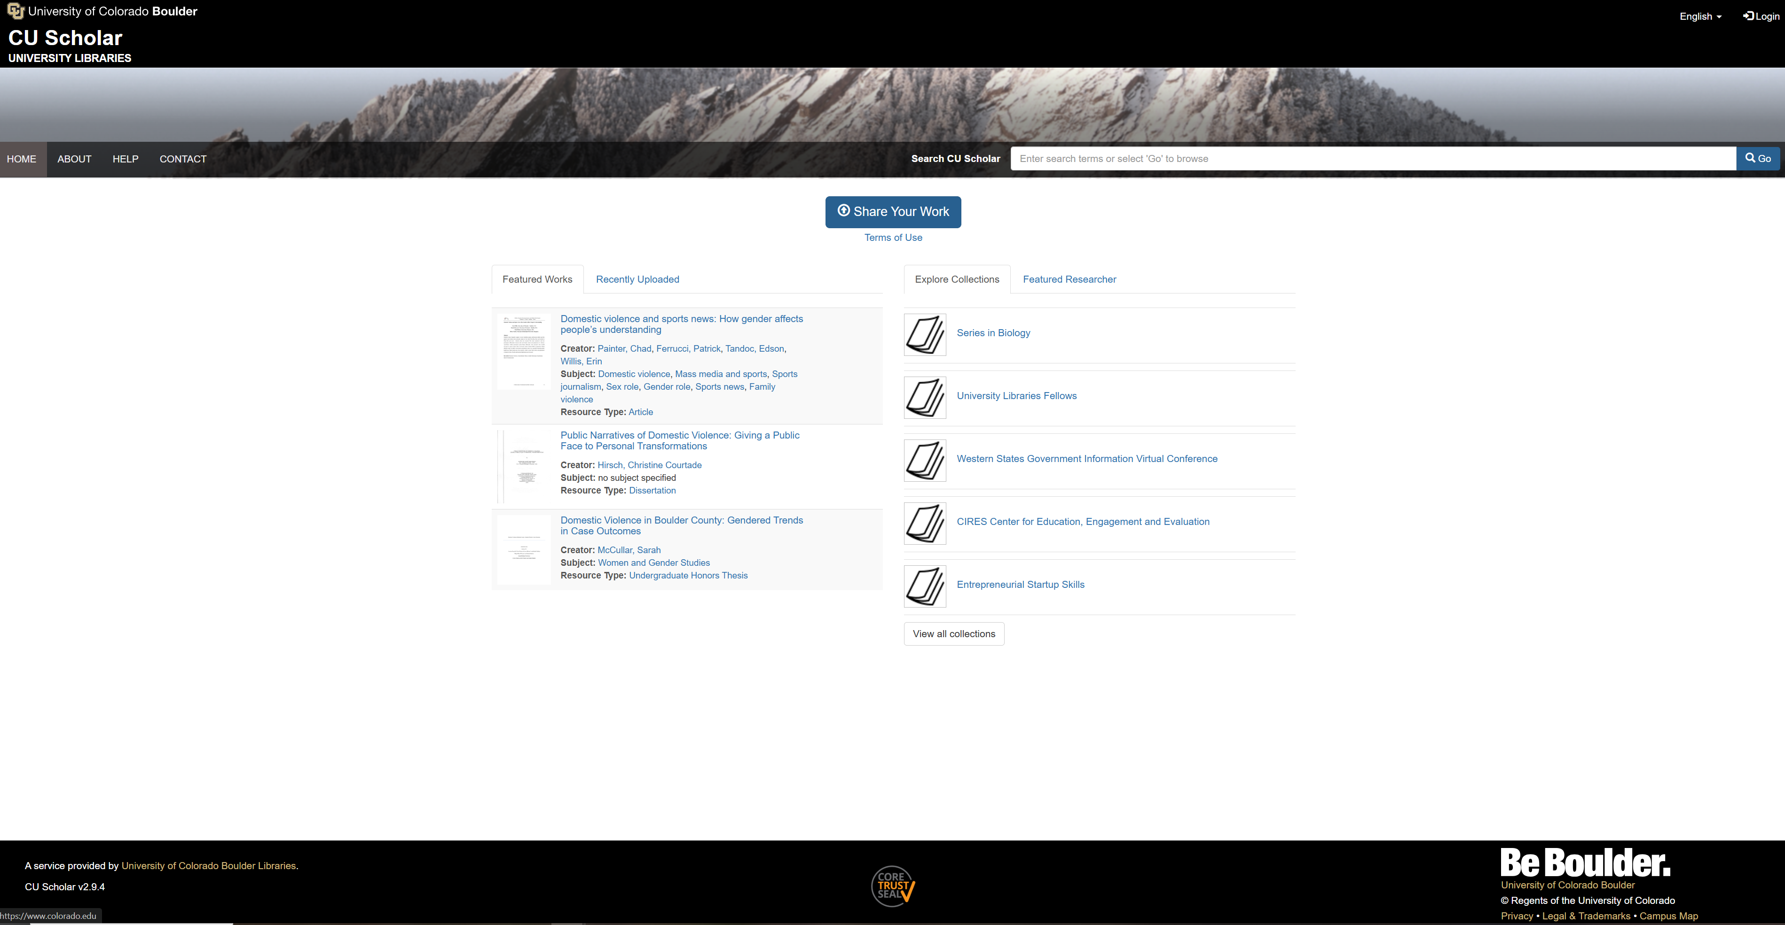

Slide 9
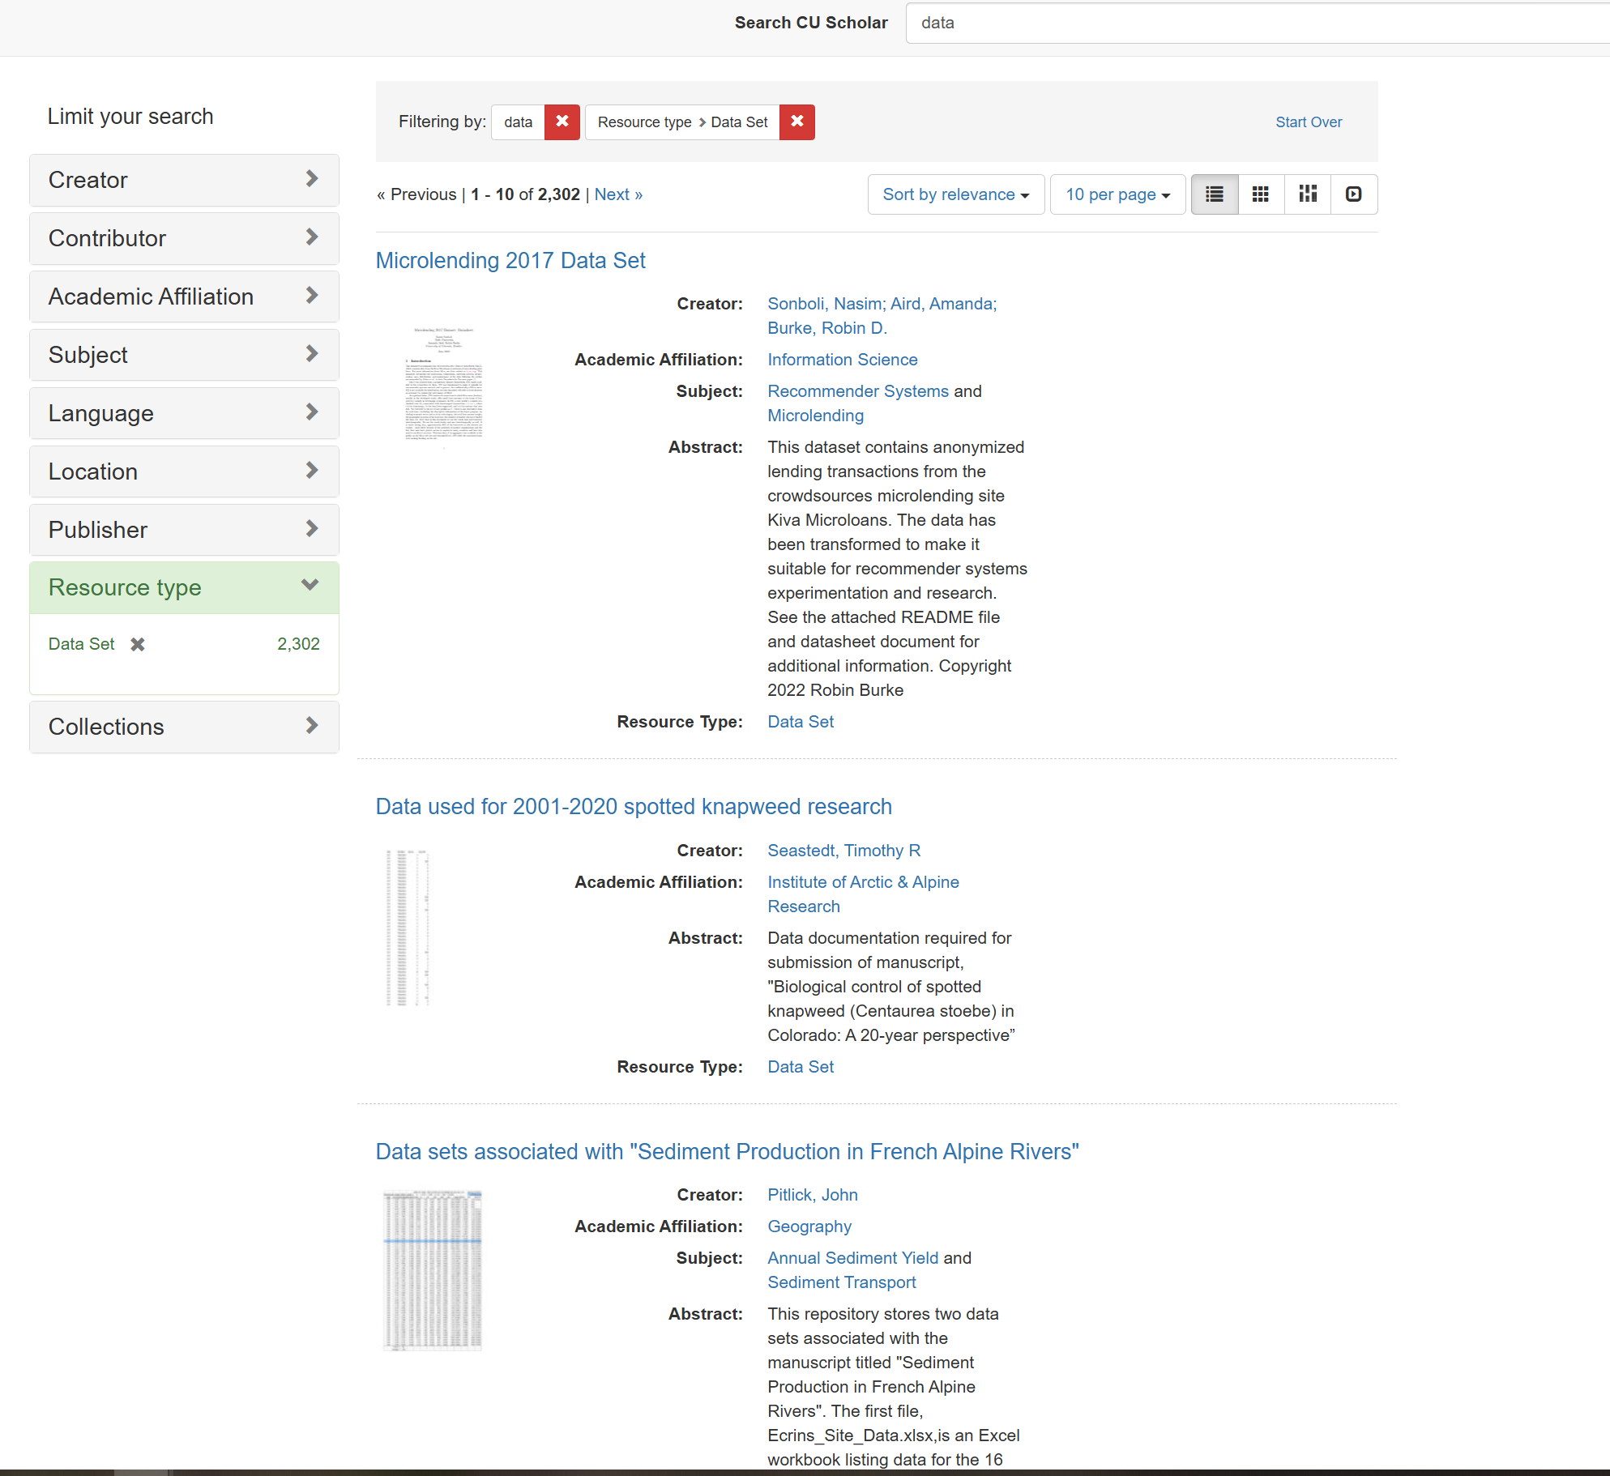

Slide 10
Data Curation
The process of ensuring that data is FAIR:
Findable
Accessible
Interoperable
Reusable
Why do we need to do this?

Slide 11
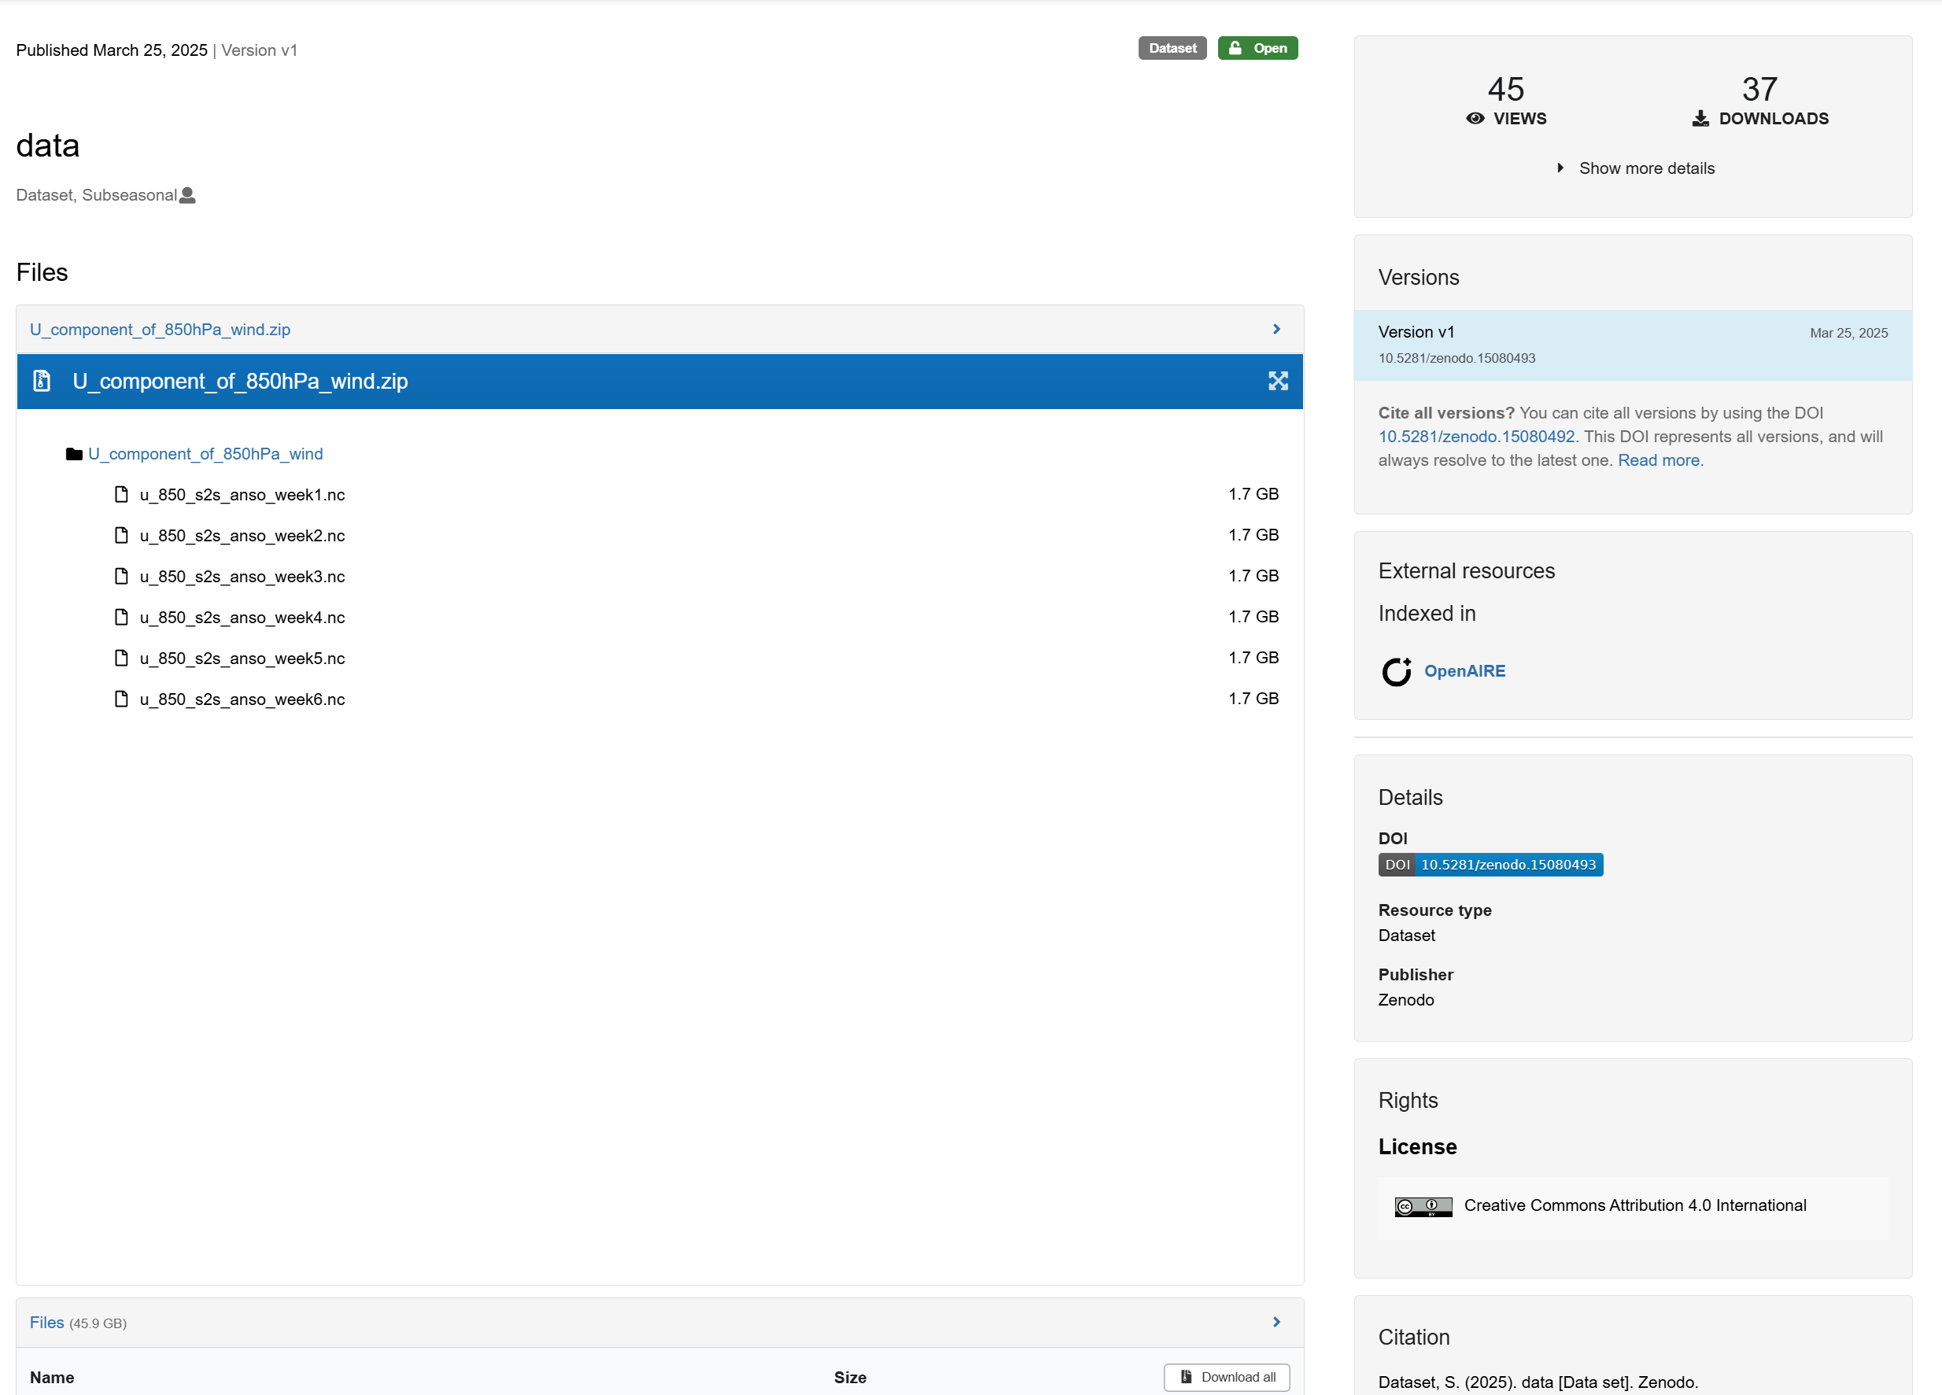
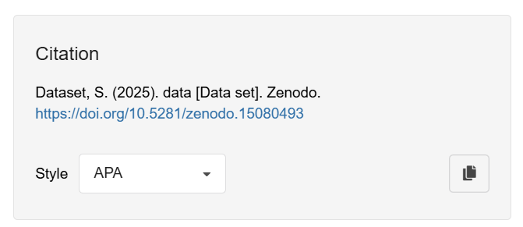

Slide 12
Data Curation Network’s CURATE(D) Steps
Check files/code and read documentation
Understand the data (or try to)
Request missing information or changes
Augment metadata for findability
Transform file formats for reuse
Evaluate for FAIRness
Document all curation activities throughout the process

Slide 13
When we use HPC resources for data curation
The data requires specific software or code that can only be run using HPC resources
The data is specific software/code that can only be run using HPC resources

Slide 14
Example
Curator cannot open/run files on their computer
Files are uploaded to a HPC server and tested
Oh no! They don’t work:
Scripts have hardcoded paths (researcher updates scripts)
Specific libraries are required (researcher adds documentation)
A different version of the software is required (researcher adds documentation)

Slide 15
Publishing Data
The data has been curated and is ready to be published
The data is ready to be reused
The documentation is complete
There’s accurate metadata (authors, etc.)
A DOI has been issued
Problems
The dataset is too big for the institutional repository
The dataset requires HPC resources to be used

Slide 16
Framework for big data publishing at CU Boulder
Landing page
Storage infrastructure
Data transfer

Slide 17
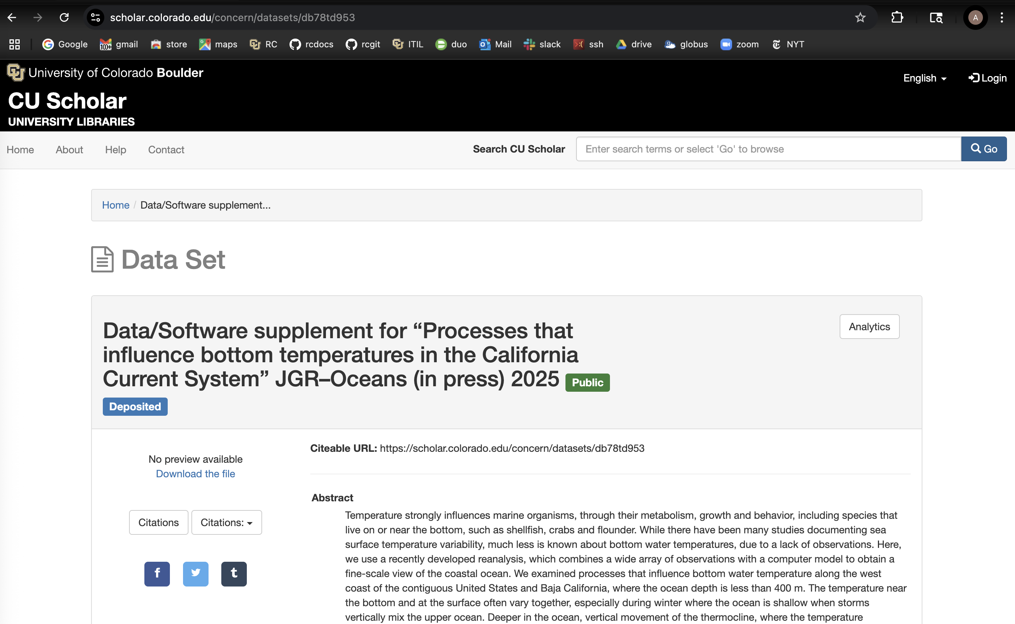
Landing Page
CU Libraries host on CU Institutional repository:
https://scholar.colorado.edu

Slide 18
Storage Infrastructure
Is dataset
< 10 GB?
No
Yes
Host data on CU Scholar server
Host Data on CU PetaLibrary (HPC)
Customer downloads with https (browser)
Customer downloads with Globus
Managed by Libraries
Managed by CU
Research Computing

Slide 19
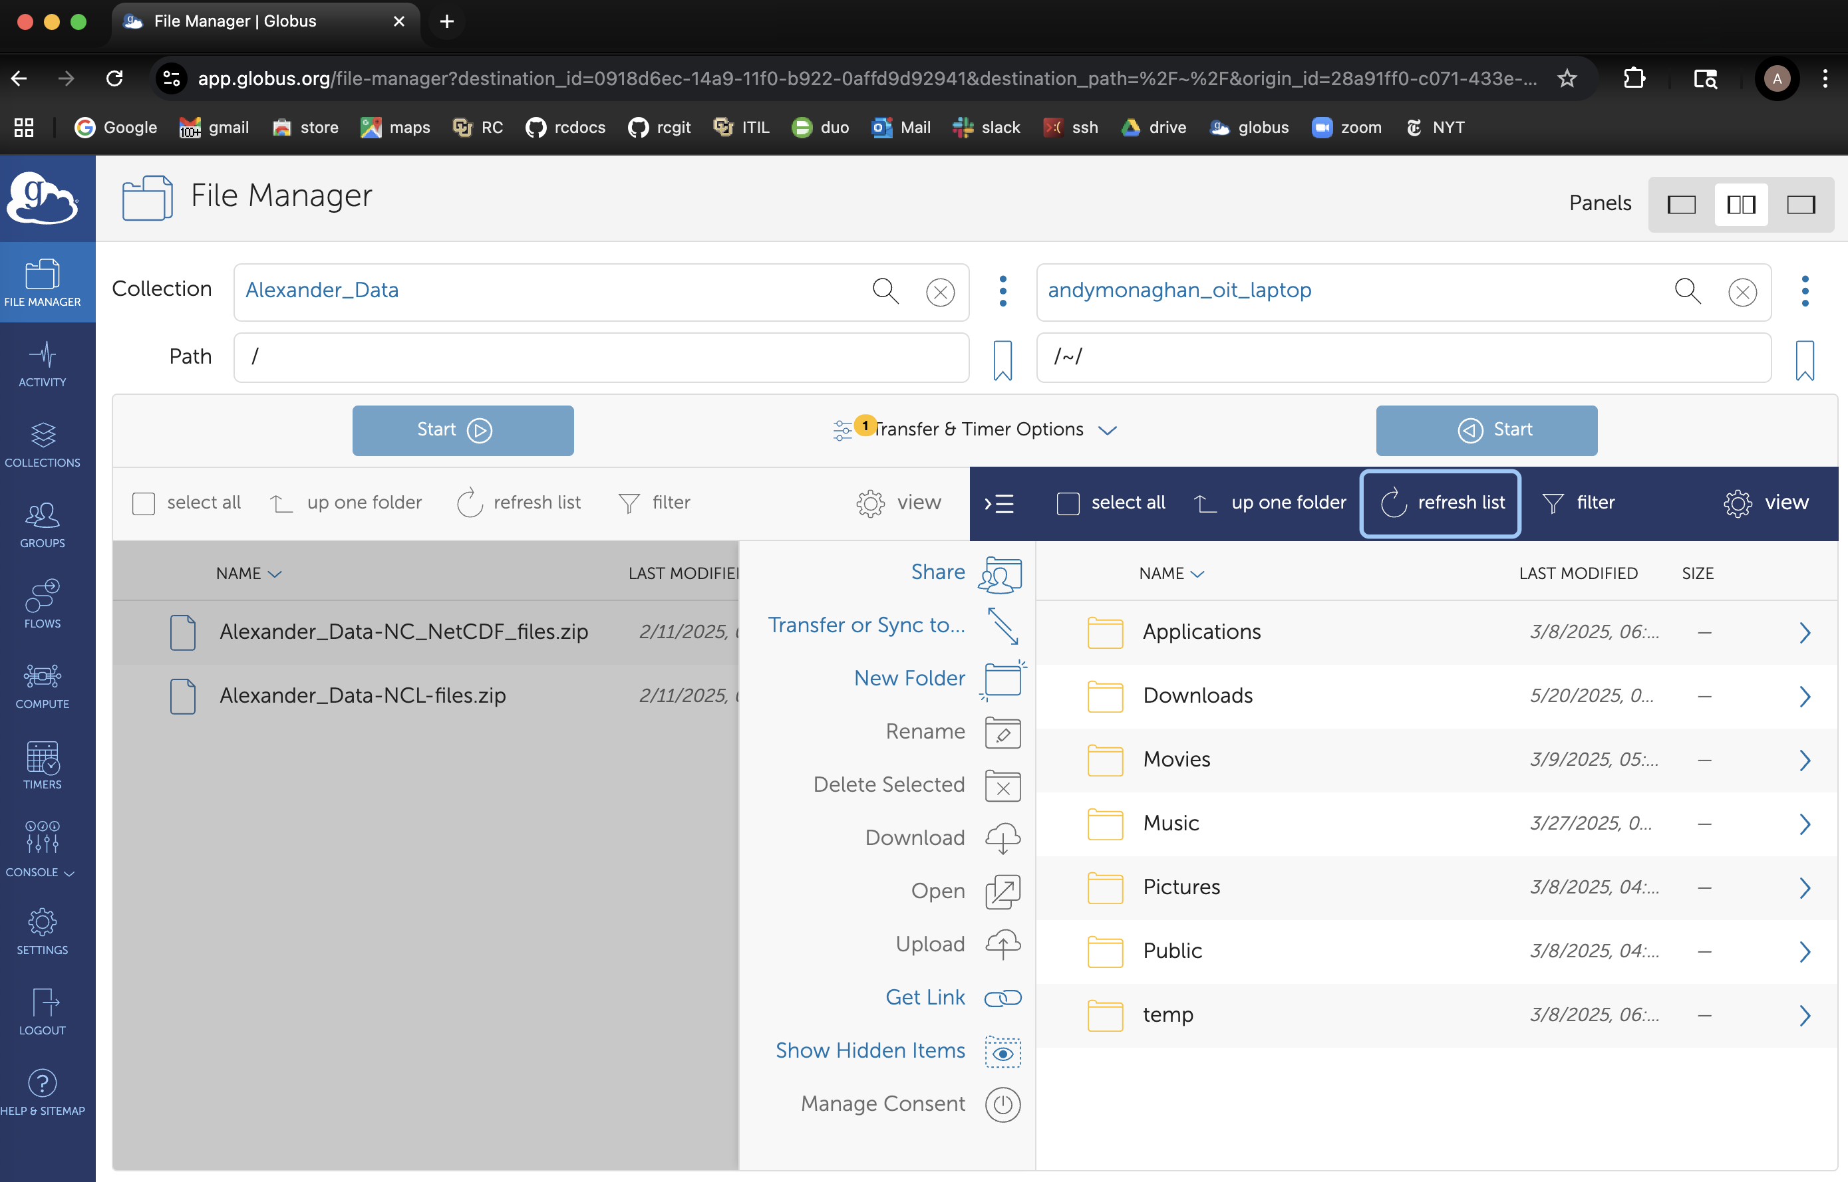
Data Transfer for "big data" publications
Uses Globus
GridFTP transfer protocol
Fast, stable, fault tolerant
Anyone can use Globus
Guidance provided on CU Scholar landing page

Slide 20
Costs
Is there a cost for publishing large datasets at CU Boulder?
If size < 500 GB: No
If size > 500 GB: Yes ($450/TB)
If the data is related to a student’s thesis or dissertation we’ll talk with them to see what we can do (this hasn’t happened yet)

Slide 21
How to get started:
Email cuscholaradmin@colorado.edu ​
We can advise on data curation, assist with data upload, etc.
Reach out to the libraries/IR administrators at your institution

Slide 22
Future
How can we expand use of HPC resources to provide increased access to datasets?
Emulation
Virtual access
Containers

